Slide 1

Exploratory Data Analysis
Joy, Linda, Maggie, Haijing, Hanyun

Slide 2
Contents
1. Solar Usage – Hanyun
2. GDP - Wen-Ling (Linda), Chang
3. Population - Wen-Ling (Linda), Chang
4. Climate - Joy
5. Foreign Direct Investment – Maggie
6. Fueling stations –Maggie
7. Electricity Price - Maggie
8. Electricity Generation by source analysis – Haijing

Slide 3
How the United States uses energy¹
Americans use a lot of energy in homes, in businesses, and in industry, and to travel and transport goods. There are four end-use sectors that purchase or produce energy for their own consumption and not for resale:
Residential Sector: includes homes and apartments.
Commercial Sector: includes offices, malls, stores, schools, hospitals, hotels, warehouses, restaurants, and places of worship and public assembly.
Industrial Sector: includes facilities and equipment used for manufacturing, agriculture, mining, and construction.
Transportation Sector: includes vehicles that transport people or goods, such as cars, trucks, buses, motorcycles, trains, aircraft, boats, barges, and ships.
These end-use sectors consume energy from primary energy and purchase and use most of the electricity (a secondary energy source) the electric power sector produces and sells. The electric power sector consumes primary energy to generate electricity for sale to the other four sectors and for export to Canada and Mexico. The end-use sectors also produce some electricity for their own use (called direct use).

Slide 4
US: Retail Sales Of Electricity
The trend of retail sales of electricity
Notes:
The trend of retail sales of electricity

Slide 5
Part 1: Solar Usage
Presented by Hanyun

Slide 6
US: Utility Scale vs Distributed Solar
The amount of solar energy produced by utility scale photovoltaic grows faster than distributed small-scale photovoltaic
Notes:
Overall united states solar energy that are generated by utility scale photovoltaic vs generated by small scale distributed solar panels.
Note the seasonal change

Slide 7
US: Percentage of distributed energy in solar energy
The percentage of solar energy produced by distributed small-scale PV is decreasing.
Generation from small-scale photovoltaic (PV) systems totaled about 34% of the annual generation from all U.S. solar PV electricity generators in 2019

Slide 8
US: distributed-PV generation by sector
The majority of distributed solar PV generation comes from the residential sector

Slide 9
US: Percentage of residential sector distributed solar energy in total distributed solar
The percentage of residential distributed solar PV in all distributed solar PV is increasing

Slide 10
State analysis
States where the residential sector is the main user for distributed solar energy:
California
Arizona
New York
Hawaii

Slide 11
California: distributed-PV by sector
In 2019, the residential sector contributes 62% of distributed solar generation in California.

Slide 12
California: residential
The relationship between electricity sales and distributed solar generation is negatively related.
In summer, when solar energy is more available, there is increase in distributed solar generation, and a decrease in electricity sales.
In winter, when solar energy is less available, there is decrease in distributed solar generation and increase in electricity sales.

Slide 13
Arizona: distributed-PV by sector
In 2019, the residential sector contributes 70% of distributed solar generation in Arizona.

Slide 14
Arizona: residential
The relationship between electricity sales and distributed solar generation is negatively related.
In summer, when solar energy is more available, there is increase in distributed solar generation, and a decrease in electricity sales.
In winter, when solar energy is less available, there is decrease in distributed solar generation and increase in electricity sales.

Slide 15
New York: distributed-PV by sector
In 2019, the residential sector contributes 56% of distributed solar generation in New York.

Slide 16
New York: residential
The relationship between electricity sales and distributed solar generation is negatively related.
In summer, when solar energy is more available, there is increase in distributed solar generation, and a decrease in electricity sales.
In winter, when solar energy is less available, there is decrease in distributed solar generation and increase in electricity sales.

Slide 17
Hawaii: distributed-PV by sector
In 2019, the residential sector contributes 60% of distributed solar generation in Hawaii.

Slide 18
Hawaii: residential
The relationship between electricity sales and distributed solar generation is negatively related.
In summer, when solar energy is more available, there is increase in distributed solar generation, and a decrease in electricity sales.
In winter, when solar energy is less available, there is decrease in distributed solar generation and increase in electricity sales.

Slide 19
Part 2: GDP and Electricity Demand
Presented by Wen-Ling (Linda), Chang

Slide 20
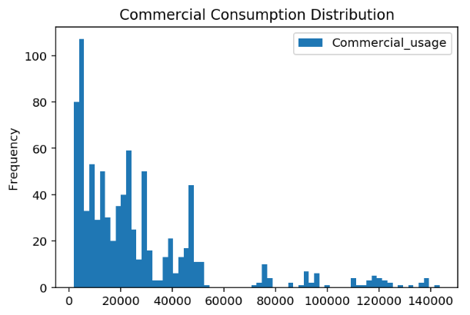
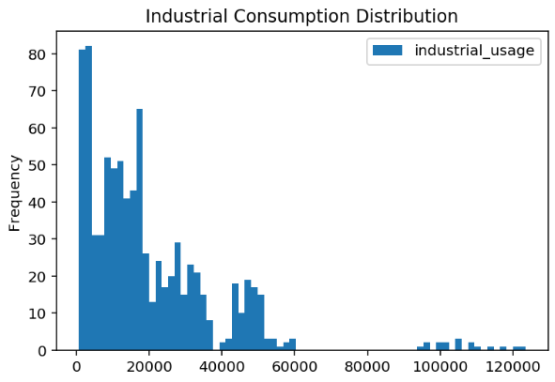
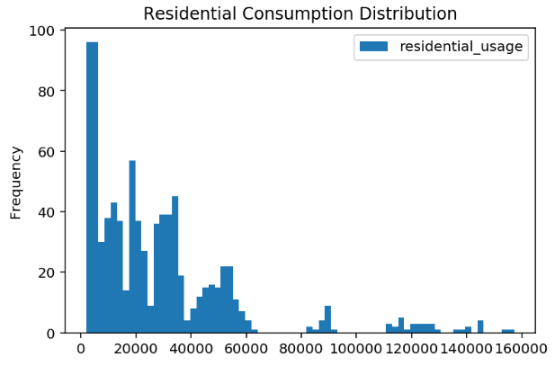
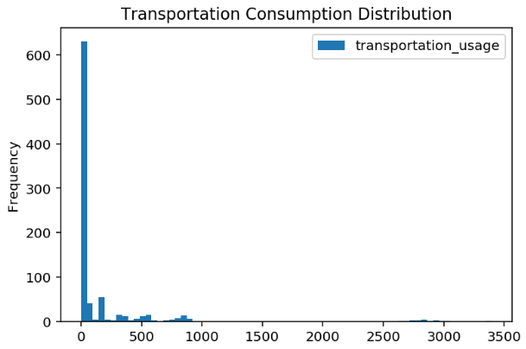
Commercial/Industrial/Residential/Transportation Consumption Distribution
Most of Commercial/Industrial/Residential activities in each state consumed less than 30,000 million kilowatt-hours in a year.

Slide 21
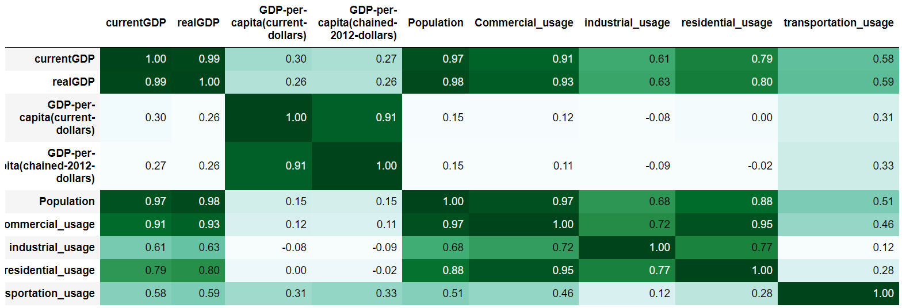
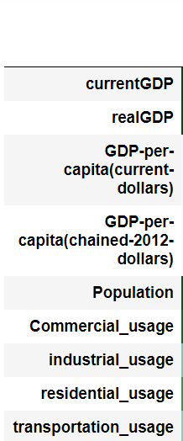
Correlation Matrix
Population has the highest correlation value in almost all sectors compared to current GDP, real GDP, and GDP per capita.

Slide 22
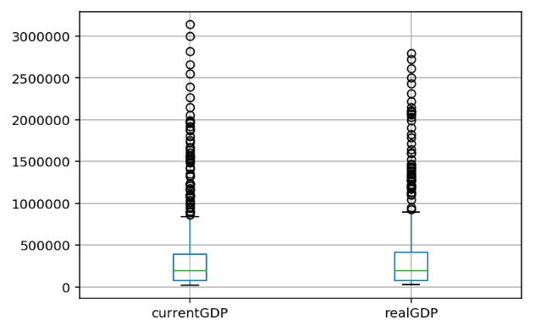
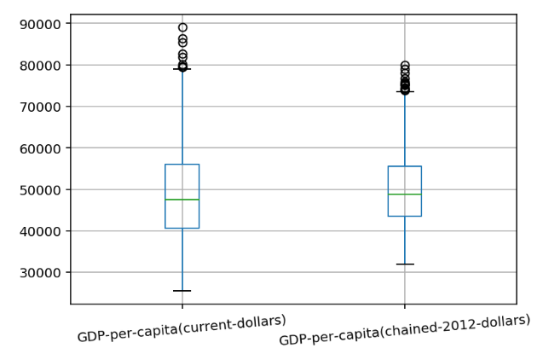
Not surprisingly, there is a greater variation in current GDP relative to real GDP. GDP per capita (current US$) also varies more than GDP per capita(chained-2012-dollars)
Units: millions of dollars
Units: dollar

Slide 23
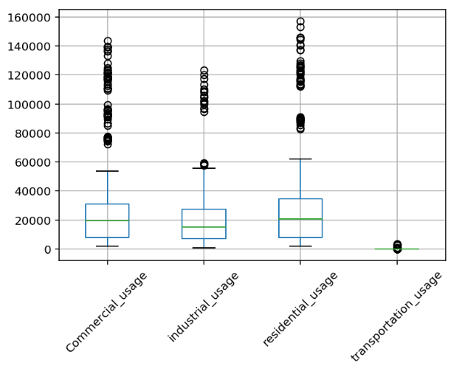
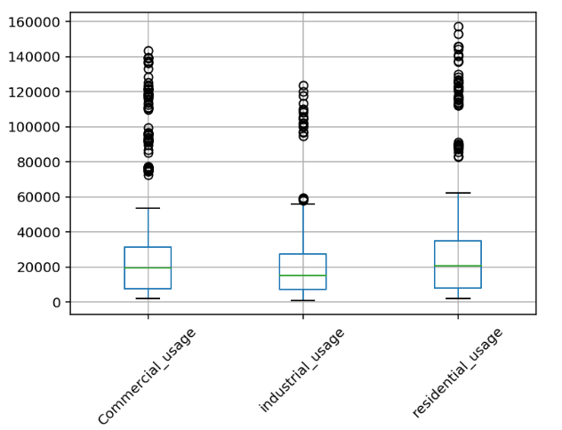
1. Transportation usage accounts only a small portion of electricity usage among all sectors. 2. Every year, residential use of electricity among states has the greatest variance among all sectors.

Slide 24
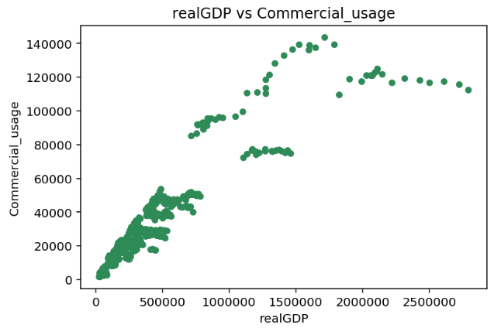
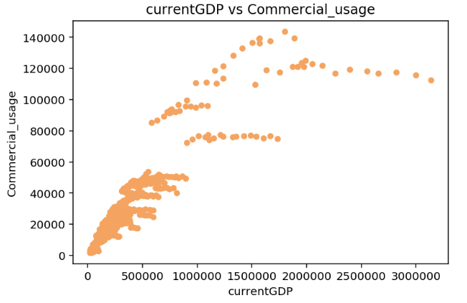
Commercial Usage
Based on the scatter plot, there seems to be a positive correlation between GDP and commercial consumption.
When current and real GDP are below around 800,000 millions of dollars, GDP is strongly correlated to commercial consumption
Units: million kilowatt-hours
Units: million kilowatt-hours
Units: millions of dollars
Units: millions of dollars

Slide 25
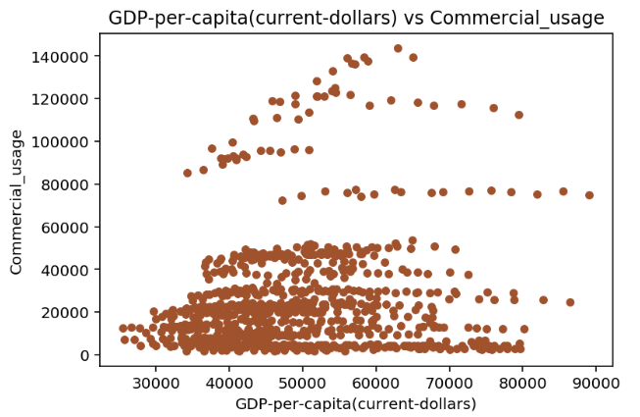
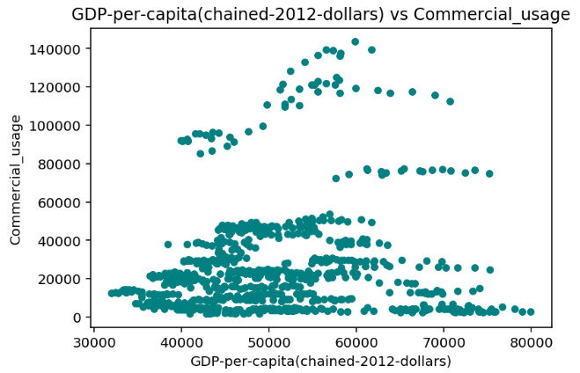
Commercial Usage
Based on the scatter plot, there seems to be no relationship between GDP per capita and commercial usage.
Units: million kilowatt-hours
Units: million kilowatt-hours
Units: dollars
Units: dollars

Slide 26
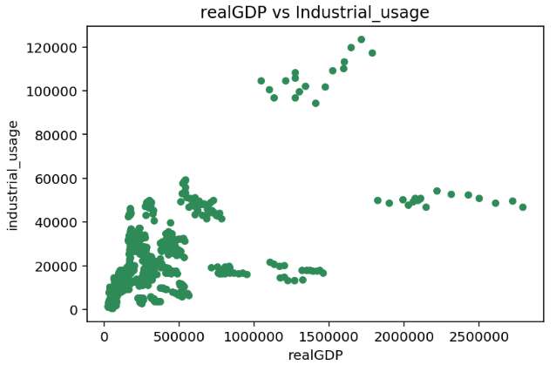
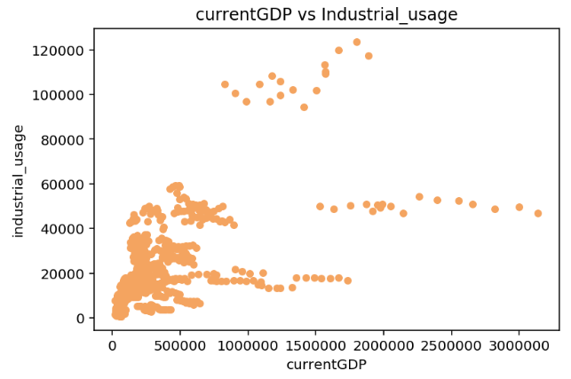
Industrial Usage
When current and real GDP are above 500,000 millions of dollars, there are two groups of industrial demand trend among states
Units: million kilowatt-hours
Units: million kilowatt-hours
Units: millions of dollars
Units: millions of dollars

Slide 27
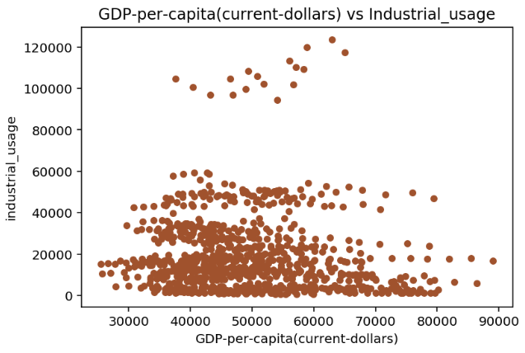
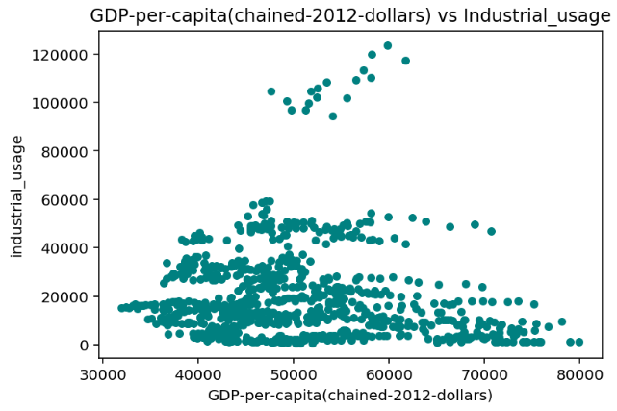
Industrial Usage
Based on the scatter plot, there seems to be no relationship between GDP per capita and industrial usage.
Units: million kilowatt-hours
Units: million kilowatt-hours
Units: dollars
Units: dollars

Slide 28
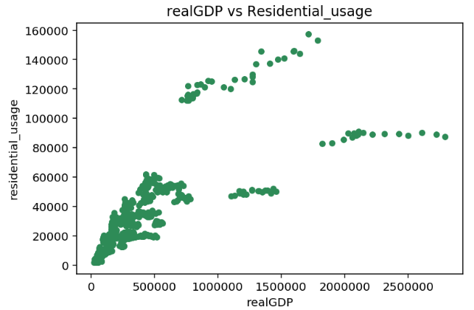
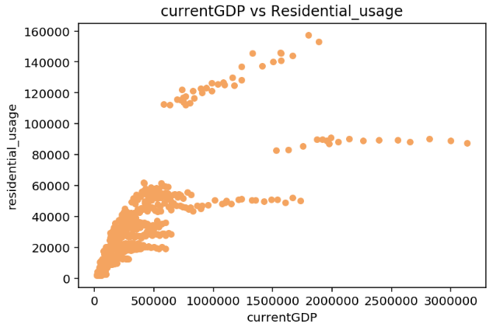
Residential Usage
When current and real GDP are above 800,000 millions of dollars, there are two groups of residential demand trend among states
Units: million kilowatt-hours
Units: million kilowatt-hours
Units: millions of dollars
Units: millions of dollars

Slide 29
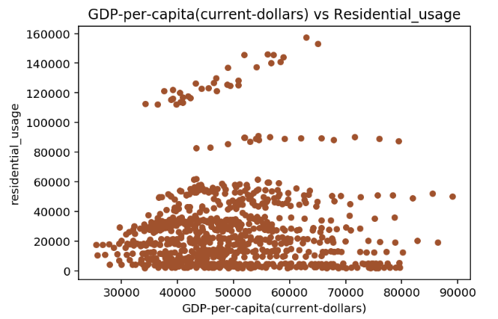
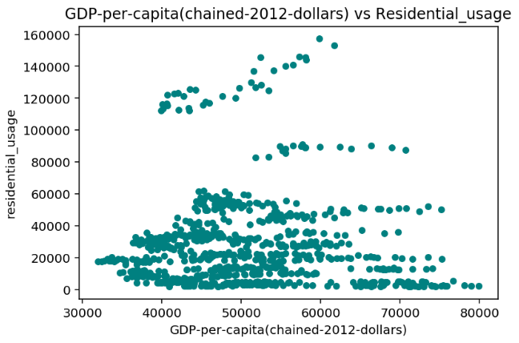
Residential Usage
Based on the scatter plot, there seems to be no relationship between GDP per capita and residential usage.
Units: million kilowatt-hours
Units: million kilowatt-hours
Units: dollars
Units: dollars

Slide 30
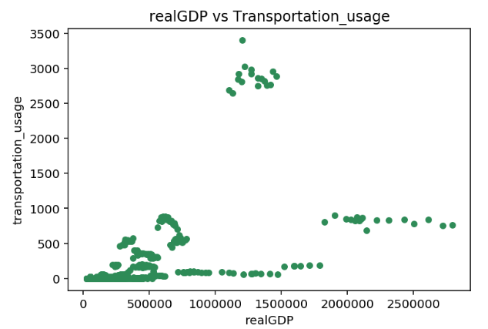
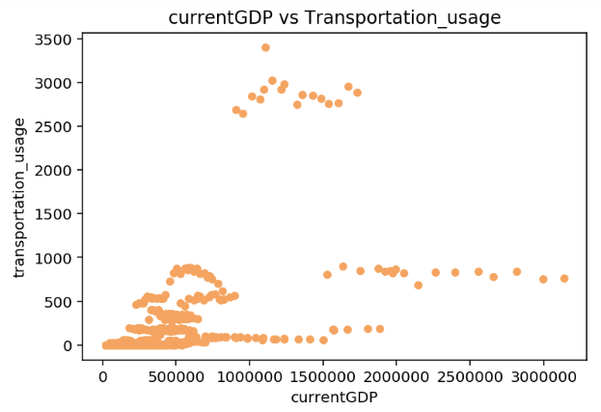
Transportation Usage
Transportation electricity demand seems not related to real GDP and Current GDP
Units: million kilowatt-hours
Units: million kilowatt-hours
Units: millions of dollars
Units: millions of dollars

Slide 31
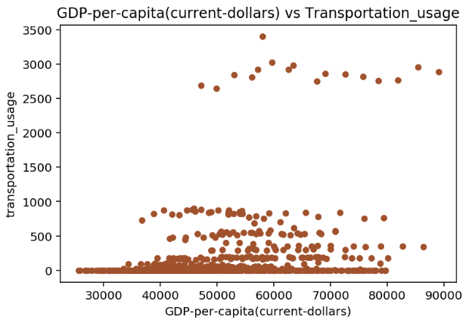
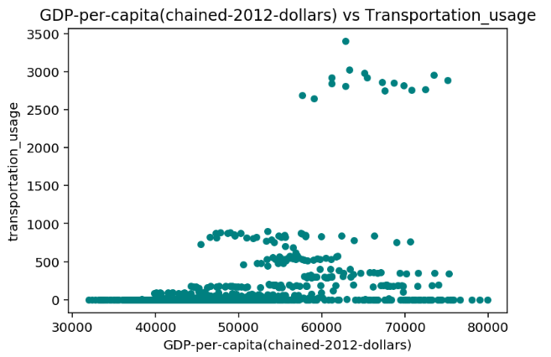
Transportation Usage
Based on the scatter plot, there seems to be no relationship between GDP per capita and transportation usage.
Units: million kilowatt-hours
Units: million kilowatt-hours
Units: dollars
Units: dollars

Slide 32
Part 3: Population and Electricity Demand
Presented by Wen-Ling (Linda), Chang

Slide 33
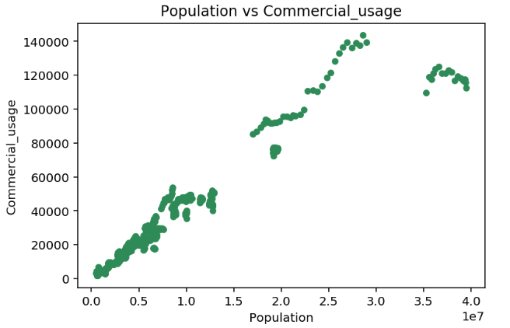
Commercial Usage
Based on the scatter plot, there seems to be a medium to strong correlation between population and commercial consumption.
Interestingly, when the state population is below 10 million people, number of people seems to be strongly correlated to commercial consumption.

Slide 34
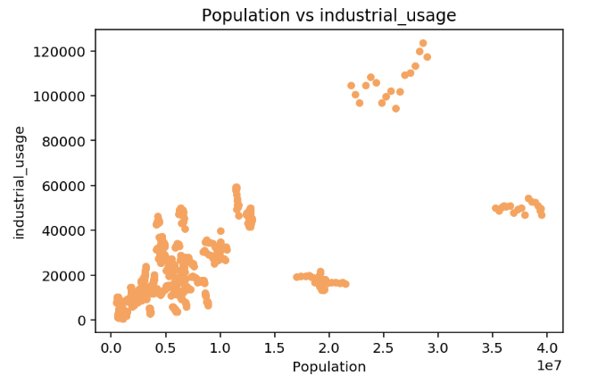
Industrial Usage
There seems to be no obvious relationship between industrial consumption and population

Slide 35
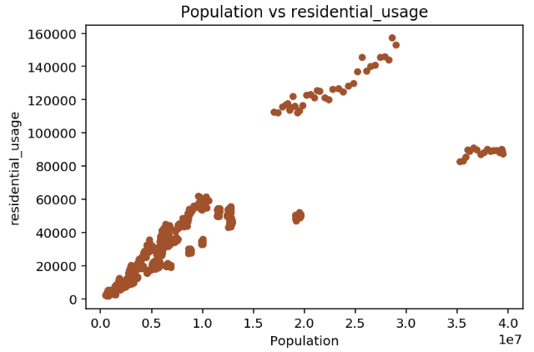
Residential Usage
Similar to the Commercial usage scatter plot, when the state population is below 10 million people, number of people seems to be strongly correlated to commercial consumption.

Slide 36
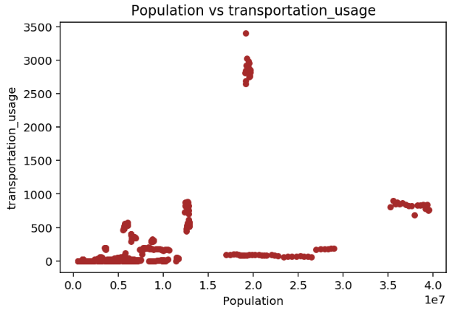
Transportation Usage
There seems to be no relationship between transportation consumption and population

Slide 37
Further exploration of the population parameter
Interestingly, based on the graph when the state population is below 10 million people, number of people is highly correlated to commercial consumption.
Thus I tried to explore the detailed relationship by selecting one state that the population is below 10 million people.
Wyoming has lowest population in the united states, and the number of people in this state is below 1 million people. Thus, I Select the state Wyoming to explore the relation
After specifically choosing a state where the population is below 10 million men and women, the connection seems less apparent

Slide 38
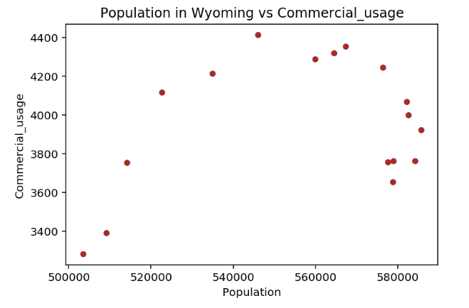
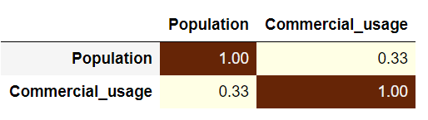
[U.S. State] Wyoming Population vs. Commercial Usage
Average population of Wyoming in 2003-2019: 556942 people
The connection seems less apparent between population and commercial usage

Slide 39
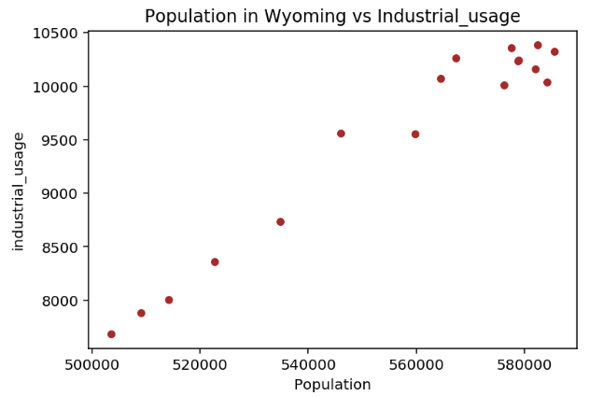
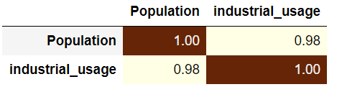
[U.S. State] Wyoming Population vs. Industrial Usage
There seems to be a strong connection between population and industrial usage

Slide 40
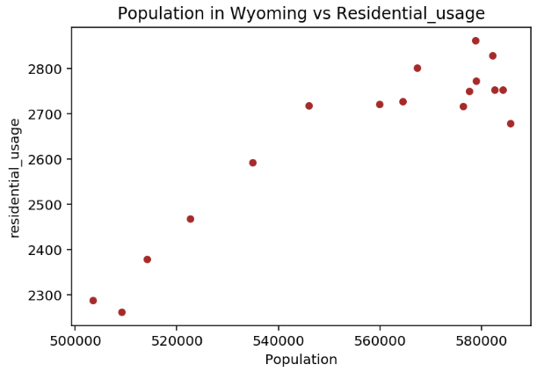
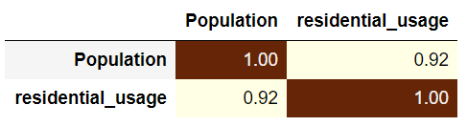
[U.S. State] Wyoming Population vs. Residential Usage
There seems to be a strong connection between population and residential usage

Slide 41
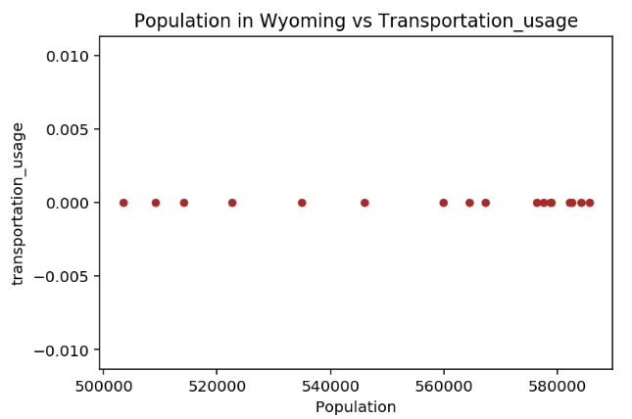
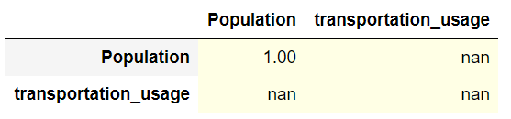
[U.S. State] Wyoming Population vs. Transportation Usage
There seems to be no connection between population and transportation usage

Slide 42
Part 4: Climate
Presented by Zhaoyu (Joy), Qiao

Slide 43
Variable Definition
Snow
SNOW - Snowfall
DSND - Number days with snow depth > 1 inch(25.4mm) for the period.
Precipitation
PRCP - Precipitation
Temperature measured by day
HTDD - Heating degree days
CLDD - Cooling Degree Days
HDSD - Heating Degree Days Season to Date
CDSD - Cooling Degree Days Season to Date
DX32 - Number days with maximum temperature < 32 F.
DX90 - Number days with maximum temperature > 90 F (32.2C)
Temperature measured by value
TMAX - Maximum temperature
TAVG - Average Temperature.
TMIN - Minimum temperature
Wind
AWND - Average wind speed
Notes:
Degree days are based on the assumption that when the outside temperature is 65°F, we don't need heating or cooling to be comfortable. Degree days are the difference between the daily temperature mean, (high temperature plus low temperature divided by two) and 65°F. If the temperature mean is above 65°F, we subtract 65 from the mean and the result is Cooling Degree Days. If the temperature mean is below 65°F, we subtract the mean from 65 and the result is Heating Degree Days.
https://www.weather.gov/key/climate_heat_cool

Slide 44
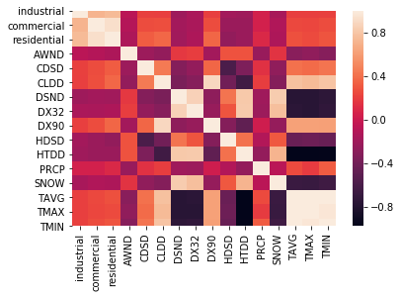
Correlation Matrix
Positively correlated:
Three types of Electricity consumption
Climate relation
High temperature is related to more cooling degree days, number of days with maximum temperature > 90 F and extra.
Negatively correlated:
Climate relation
Cooling Degree Days and Heating degree days
Temperature Number days with snow depth > 1 inch(25.4mm) for the period
Temperature with Number days with maximum temperature < 32 F

Slide 45
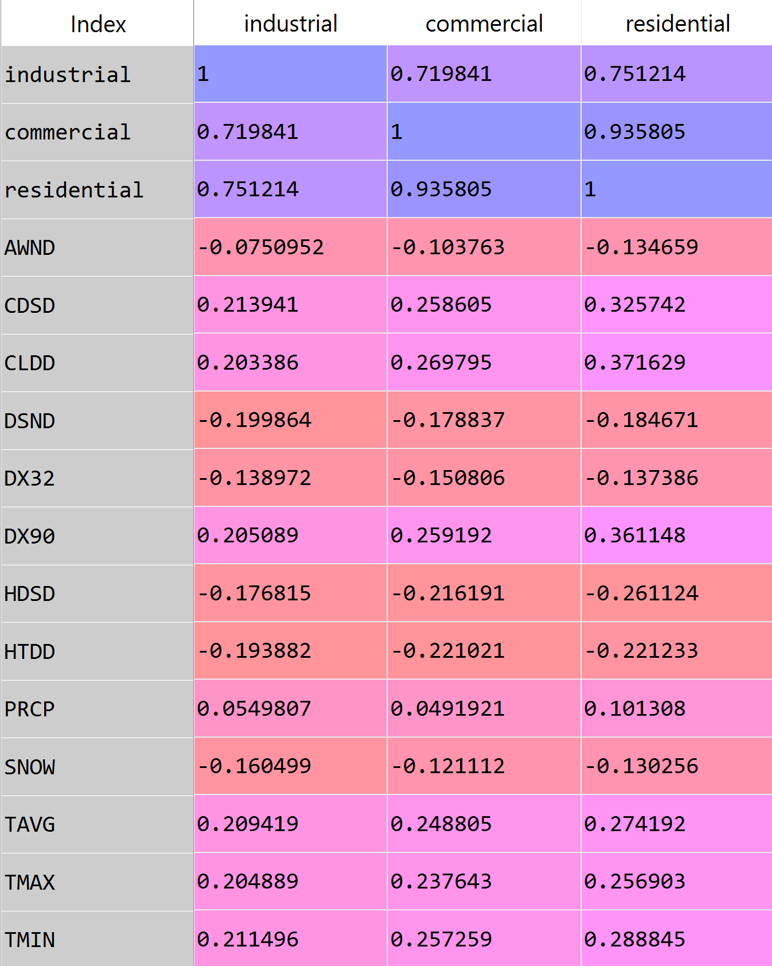
Correlation Matrix
The correlation coefficient between Climate attributes and electricity consumptions are low. The highest one is between Cooling Degree Days and Residential electricity consumption with a value of 0.37.

Slide 46
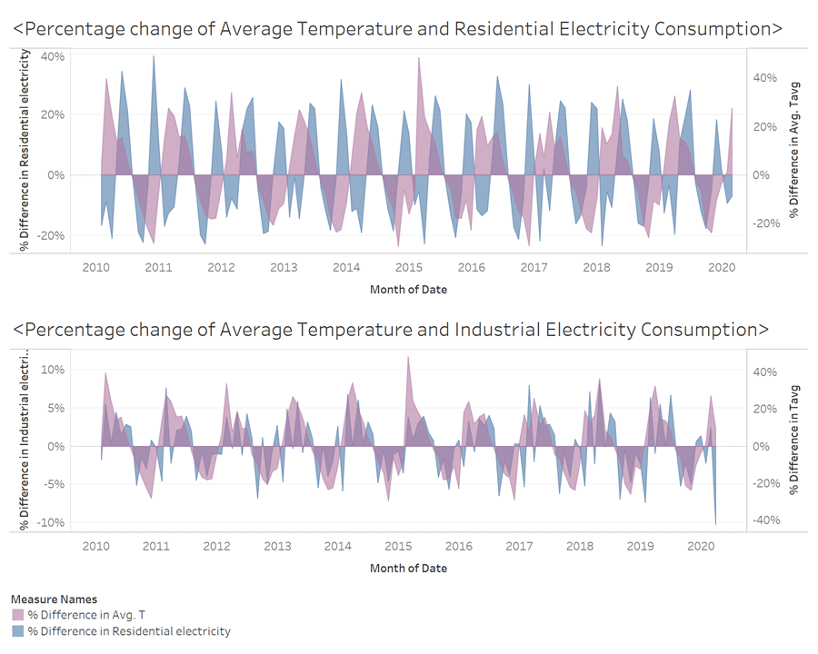
Percentage change of Average Temperature and Electricity Consumption
The Percentage change of Temperature and ELectricity consumption have a clear seasonal trend. In Spring and Fall, The percentage change of average temperature rise to the highest and in summer and winter the percentage change return back to 0, matching the absolute highest and lowest temperature.
The Electricity trend goes in the opposite way. We could conclude that both high and low temperature would trigger an increase in electricity consumption.
when we compare consumptions from different sector, we could see residential consumption is more sensitive to temperature change than industrial one. Industrial consumption fluctuate in a monthly pattern rather than quarterly.

Slide 47
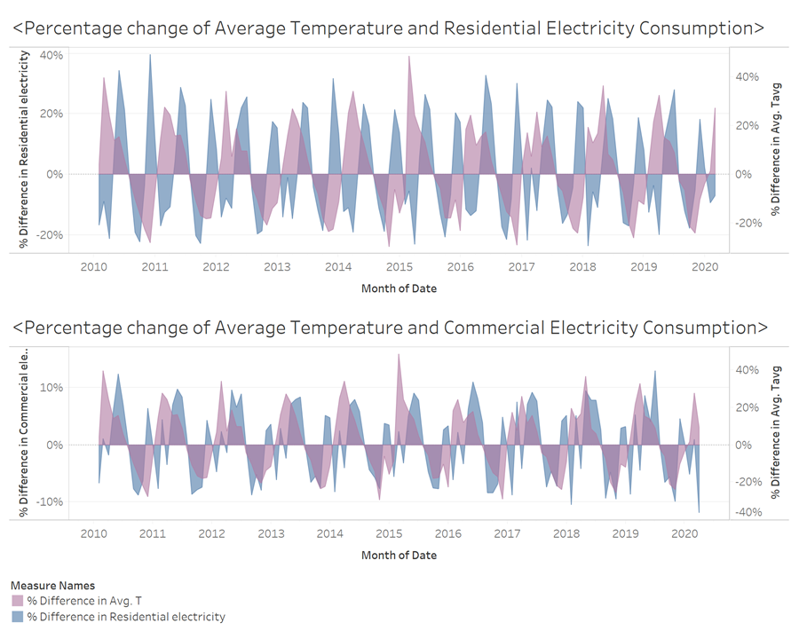
Percentage change of Average Temperature and Electricity Consumption
SImilarly when we compare consumptions from residential and commercial, we could see percentage change in commercial consumption is more like to residential.
The main reason for this difference across sectors could caused by difference in users.Electricity in Residential and Commercial sectors are closely related to people, while in industrial sector the main user of this energy are equipments and plants, thus are more independent with temperature change.

Slide 48
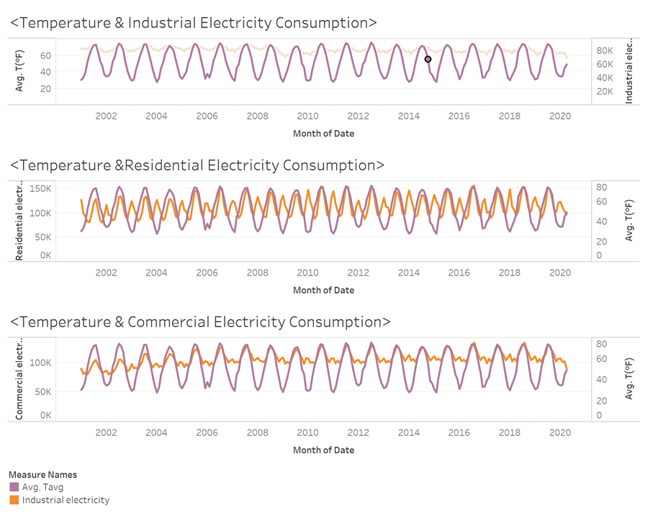
A further comparison of Temperature and Electricity consumption

Slide 49
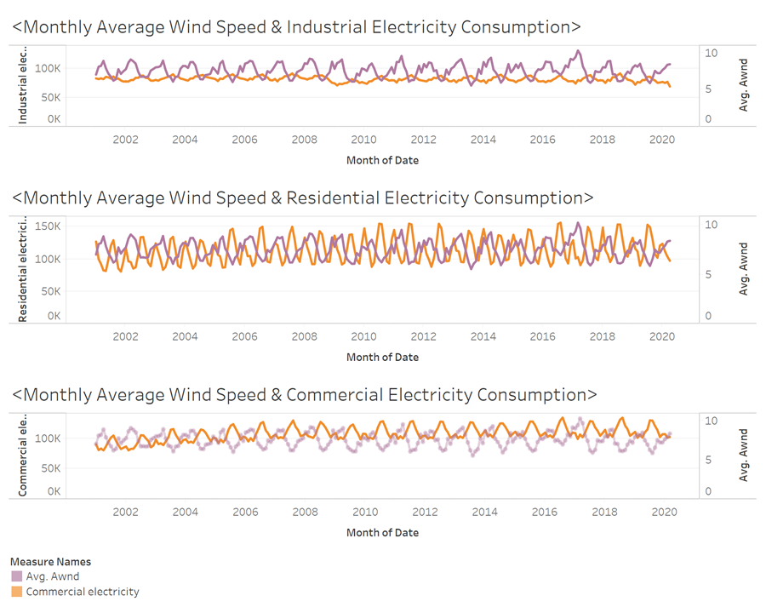
Likewise, the wind speed has a negative correlation with Electricity Consumption. And the Residential sector is most sensitive to the wind speed change.

Slide 50
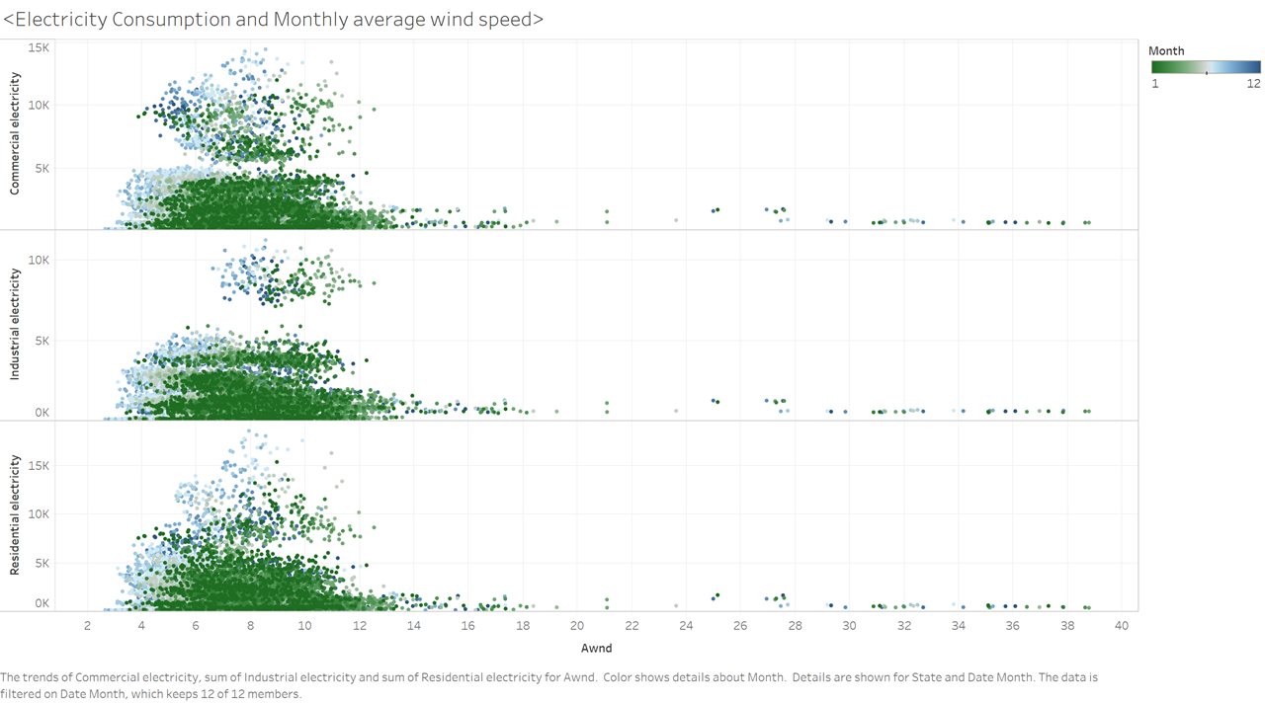
Wind speed reach to the slowest in summer. No clear correlation is observed.

Slide 51
According to the correlation matrix, Cooling Degree Days are relatively correlated to Electricity Consumption. Thus we inspect into this attributes with different consumption types.

Slide 52
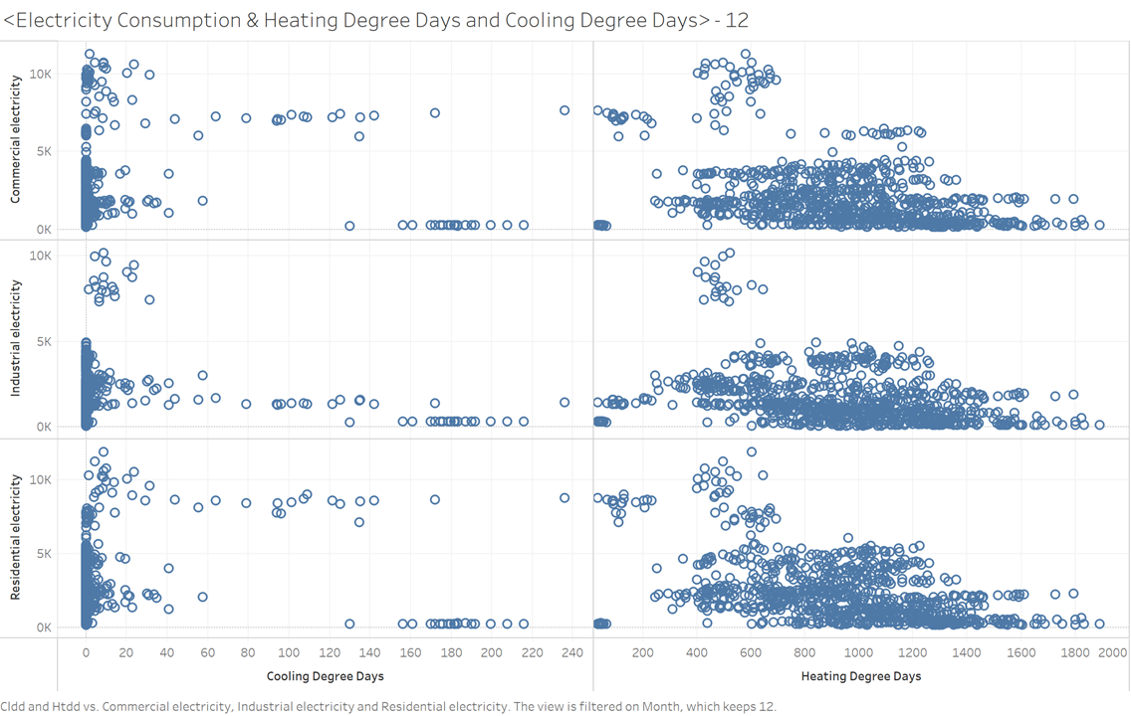
December:
Cooling Degree Days decrease to the low point while Heating Degree Days achieve to the peak.

Slide 53
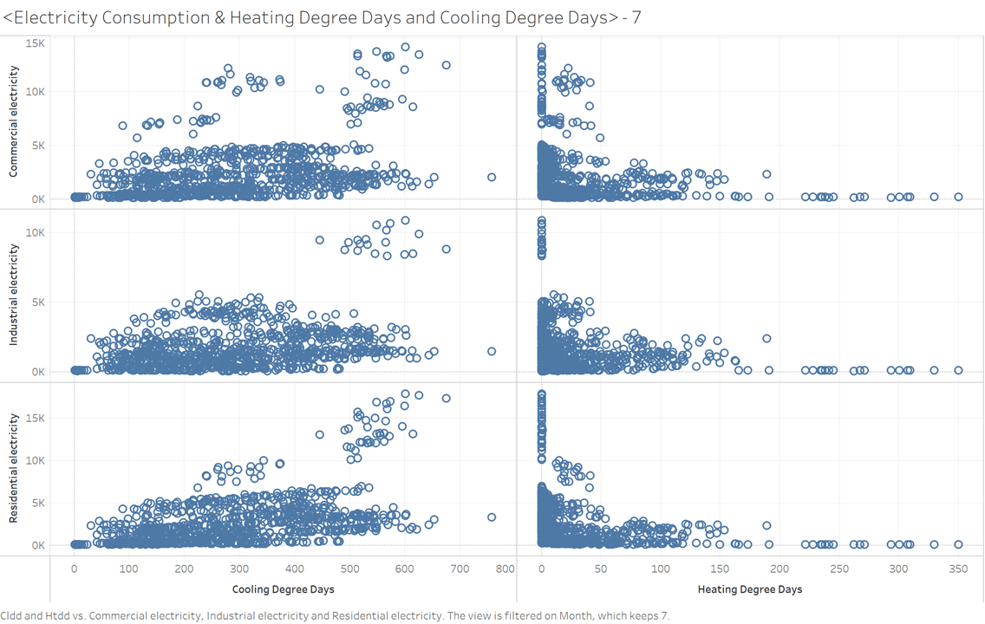
July:
Cooling Degree Days and Heating Degree Days move to the opposite direction.
Note that when cooling degree days increases, electricity consumptions also increases.

Slide 54
Part 5: Foreign Direct Investment
Presented by Yi-Chen (Maggie), Huang

Slide 55
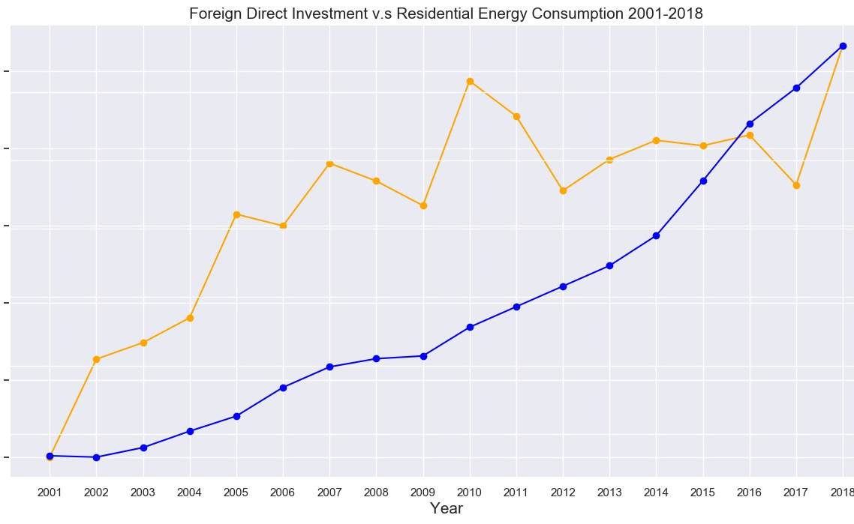
Foreign Direct Investment vs. Residential Electricity Consumption
In general, residential electricity consumption is rising. However, it is not a smooth line and cannot see special reaction between FDI and residential energy consumption.

Slide 56
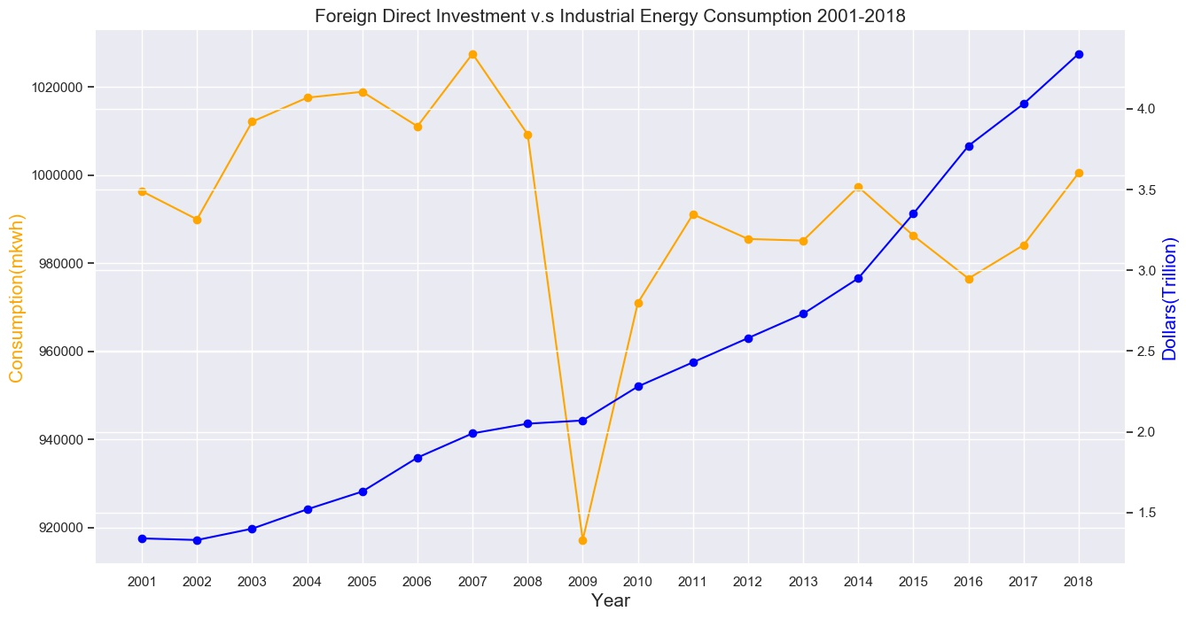
Foreign Direct Investment vs. Industrial Electricity Consumption
Unlike residential electricity consumption, industrial electricity consumption is not rising and generally remain at a level. However, in 2009, there’s a big drop. It is an interesting topic to find out the reason and maybe that attribute can become a strong attribute to do analysis.

Slide 57
The Drop is mainly explained by Global Economic Recession…
According to The Norwegian American(2009), the electricity intensive industry is made up of industries with very high electricity consumption per produced unit.
Their production is, to a large degree, aimed at the export market, which makes them more exposed to international economic cycles.
The energy consumption in the chemical and metal industry dropped in total by about 21 per cent from 2008 to 2009, while the consumption in manufacture of paper and paper products fell by about 7 per cent.
Source: https://www.norwegianamerican.com/significant-drop-in-energy-consumption-in-2009/#:~:text=Preliminary%20statistics%20shows%20that%20the,the%20lowest%20consumption%20since%201997.

Slide 58
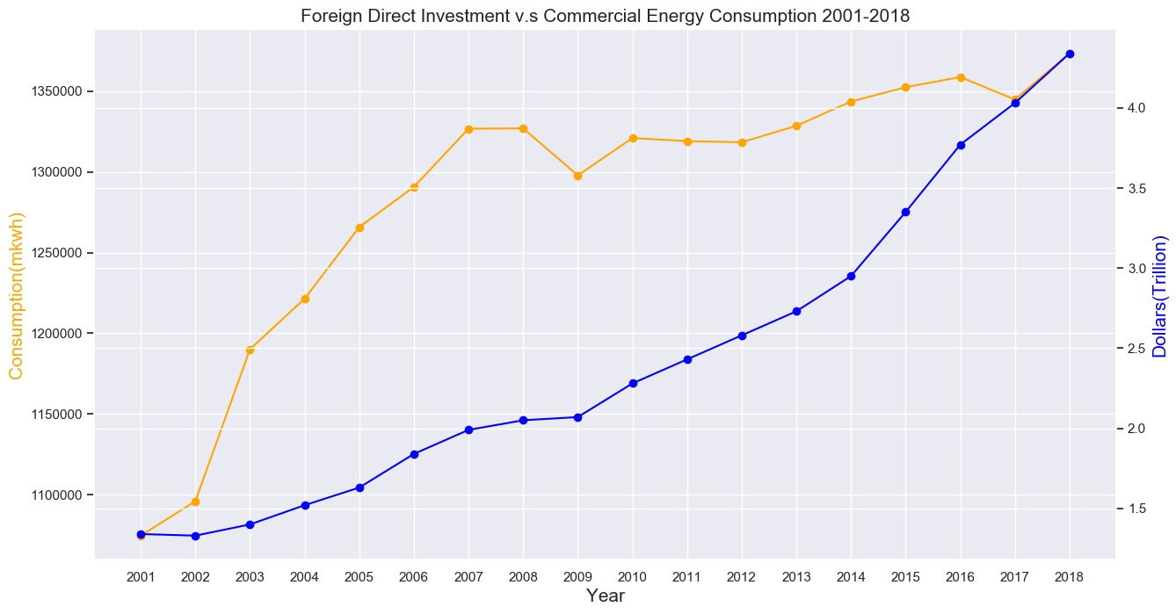
Foreign Direct Investment vs. Commercial Electricity Consumption
Compared to the previous two plots, commercial electricity consumption is rising smoothly and become stable in five years. There’s also a small drop in electricity consumption in 2009 due to economic recession. But there’s not specific indication show’s that it is because of FDI.

Slide 59
There’s no specific pattern shown between electricity consumption and FDI in the previous plots. Therefore, this attribute might NOT be a strong attribute
when building models.

Slide 60
Part 6: Fueling Charging Station
Presented by Yi-Chen (Maggie), Huang

Slide 61

Electricity Fueling Charging Station Count vs. Total Coal Consumptions
As expected, while electric fueling station count increases, total coal consumption drops.

Slide 62

Electricity Fueling Charging Station Count vs. Total Electric Consumption
As electric fueling station count increases, total electric consumption increases, which is what we expected. Therefore, we can first assume there’s positive relationship between these two variables but we will do further analysis in the next step.

Slide 63

Biodiesel Fueling Charging Station Count vs. Total Electric Consumption

Slide 64

Hydrogen Fueling Charging Station Count vs. Total Electric Consumption

Slide 65
Lower electricity consumption but more use of biodiesel and hydrogen
In the previous two plot, we can see even though electricity consumption dropped a lot in 2009, Biodiesel and Hydrogen fueling station count had risen.
This is especially due to lower consumption of gasoline in road transport and heavy fuel oil in shipping. About 122 million litres of biodiesel were sold in 2009, which is 18 per cent less than the previous year. This made up about 4.8 per cent of diesel used for transport purposes in 2009.
Some bioethanol was sold, but this makes up only a tiny fraction of the total sale of gasoline.
Trade legislation was introduced for biofuels used in road transport, and the directed share rose from 2.5 per cent to 3.5 per cent from 1. April 2010.

Slide 66
Part 7: Electricity Price
Presented by Yi-Chen (Maggie), Huang

Slide 67
Electricity Retail Price Findings
This sector would show interesting Electricity Price time series compared to Electricity Consumption in some state from 2001/1~2020/4
Most of the time series of the retail price of electricity in every state show rising trend
Most of the time series of the commercial and residential electricity consumption in every state shows stable trend in the past decades, especially in residential sector
Industrial electricity consumption shows rising trend in some states but declines a lot in other states
Some of the state shows interesting trend that not similar to the others
Those interesting ones would show in the following slides. Interesting trends mostly appear in commercial and industrial sector.

Slide 68

7-1. Commercial Price & Consumption

Slide 69

Commercial Electricity Price vs. Electricity Consumption in Arizona
This plot shows that from 2008~2019, the time series of electricity retail price and the consumption both shows seasonal trend(the peaks are in winter). In Arizona, the shapes of the trend have the best fit upon every state. Moreover, the electricity retail price kept rising in the past decades.

Slide 70

Commercial Electricity Price vs. Electricity Consumption in North Dakota
In North Dakota, the trough and the crest shows totally opposite trend, which means when the retail price is high, people who engage in commercial activities start to use less electricity.

Slide 71

Commercial Electricity Price vs. Electricity Consumption in Massachusetts
In Massachusetts, it shows similar phenomenon as North Dakota, when the retail price is high, people tends to use less electricity. However, the trend of Massachusetts is extreme. There’s a big drop of electricity consumption from 2009~2012.

Slide 72

Commercial Electricity Price vs. Electricity Consumption in Texas
In Texas, the electricity consumption shows a bit rising in the past decades. However, the retail price shows a special trend that there’s a peak at 2008 and kept dropping until now.

Slide 73
7-2. Industrial Price & Consumption

Slide 74

Industrial Electricity Price vs. Electricity Consumption in Massachusetts
Unlike the commercial electricity price and consumption trend, Massachusetts shows a extreme high peak of using industrial electricity from 2009-2012. This is an interesting phenomenon that can research deeper.

Slide 75
Part 8: Electricity Generation by source analysis
Presented by Haijing

Slide 76
Electricity Generation
By Supply Source: Coal, Geothermal, Hydroelectric Conventional, Natural Gas, Nuclear, Other, Other Biomass, Other Gases, Petroleum, Pumped Storage, Solar, Thermal and Photovoltaic, Wind, Wood and Wood Derived, Fuels, Total
By state
Annually: 1990~2018
Monthly: Jan 2001~ Apr 2020

Slide 77
Traditional fossil energy like: Coal, Natural Gas, Petroleum still takes up a major part of electricity generation source;
Decreasing trend for coal, increasing trend for natural gas
Conventional hydroelectric
Clean energy: wind, clear increasing trend

Slide 79

Wind and Solar Energy Source by State, Time

Slide 80


Slide 81


Slide 82


Slide 83


